Slide 1
Read Only Memory(ROM) and Programmable Logic Array(PLA)
Presented By
Er. Ganesh Kumal

Slide 2
Read Only Memory(ROM)
A ROM is essentially a memory (or storage) device in which binary information is stored permanently.
A decoder generates 2^{n} min-terms of the n input variables.
Inserting OR gates to sum the min-terms of boolean function.
A ROM is a device that includes both the decoder and the OR gate within a single package.
n inputs ( Address)
2^{n} Χ m
ROM
2^{n} words
Each word contains m bits
Figure: Block diagram of ROM
m outputs

Slide 3
32 x 4 ROM
Consists 32 words of 4 bits each.
Five inputs to specify 2^{n} = 32 words (min-terms)
4 outputs (OR gates) to represent 4 bits word
Internally the ROM is a combinational circuit with AND gates connected as a decoder and number of OR gates equal to the number of outputs in the unit.
The 32 outputs of the decoder are connected through fuses to each OR gate.

Slide 4
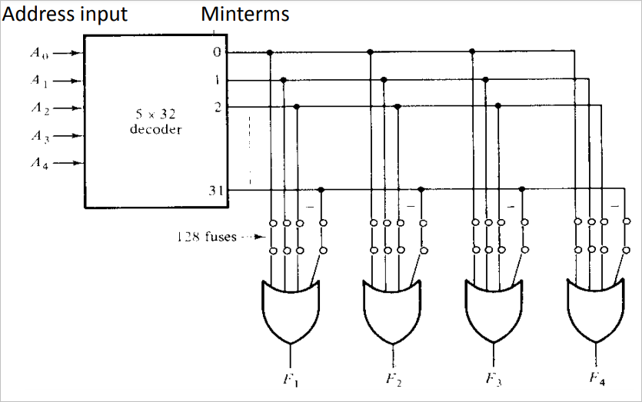
Figure: Logic construction of a 32 X 4 ROM
m-bits

Slide 5
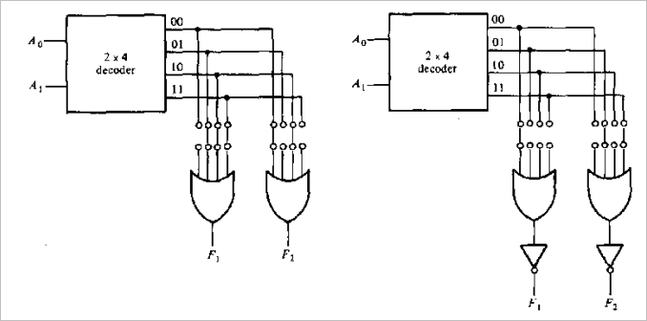
Implement following boolean function using ROM
F1 ( A1, A0) = Σ m ( 1, 2, 3)
F2 ( A1, A0) = Σ m ( 0, 2)
Truth Table
A1 | A0 | F1 | F2
0 | 0 | 0 | 1
0 | 1 | 1 | 0
1 | 0 | 1 | 1
1 | 1 | 1 | 0
Figure: Combinational circuit implemented by 4 X 2 ROM

Slide 6
Classification of PLDs
PROM
Fixed AND array constructed as a decoder and programmable (connected only required min-terms)OR array.
PLA (Programmable Logic Array)
Both the AND and OR arrays can be programmed.
PAL (Programmable Array Logic)
Programmable AND array and fixed OR array.

Slide 7
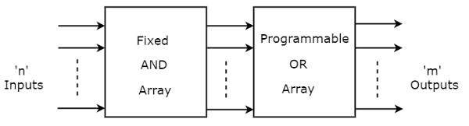
PROM
If the ROM has programmable feature, then it is called as Programmable ROM (PROM)
The PROM is a two level implementation in sum of min-terms form.
PROM is a programmable logic device that has fixed AND array & Programmable OR array. The block diagram of PROM is shown in the following figure.

Slide 8
PROM
If the ROM has programmable feature, then it is called as Programmable ROM (PROM)
The PROM is a two level implementation in sum of min-terms form.
PROM is a programmable logic device that has fixed AND array & Programmable OR array. The block diagram of PROM is shown in the following figure.

Slide 9
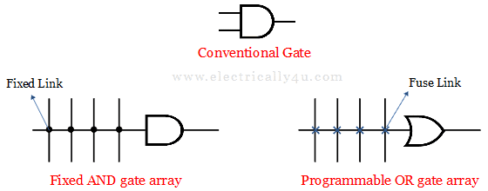
CONT…
So in order to simplify the connection between the gate array, the array logic symbol (fixed AND gate array and Programmable OR gate array) is used as shown below.
For fixed gate array, dots are placed at the intersection and for programmable gate array, fuses are placed(indicated as ‘x’) at the intersection.

Slide 10
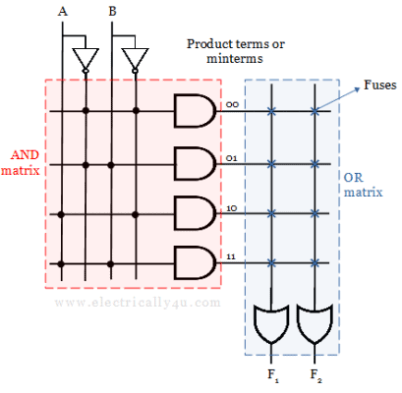
PROM
The circuit shows the representation of 4×2 PROM. Here, the two input variables are decoded into 4 lines by means of 4 AND gates and 2 NOT gates. The four outputs of the decoder represent one of the minterms of 2-input variables.
The four outputs are then connected to the OR gates through fuses. Each OR gate has 4 fuses, which depends on the number of decoded outputs from the AND gate.

Slide 11
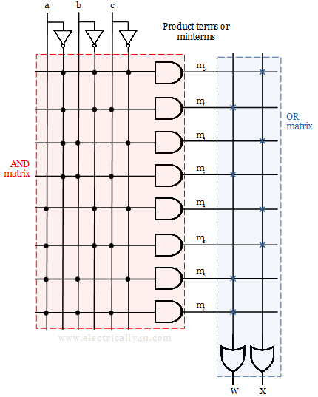
Let us realize the Boolean function
F1 (a, b, c) = ∑ m(1,3 ,6, 7) and
F2 (a, b, c) = ∑ m(0, 2, 4, 5) using PROM.
F1 F2

Slide 12
Programmable Logic Array (PLA)
In a PROM all the bit patterns available are used by decoder (AND gates) eventhough they are not used, which are waste of available equipment.
The PLA generates only required minterms.
In PLA both the AND and OR arrays can be programmed.

Slide 13
Programming Table for PLA
First, list the product terms numerically.
Second, specifies the required path between inputs and AND gates.
Third, specifies the path between the AND and OR gates.
For each output variable, we may have a T(true) or C(complement) for programming the X-OR gate

Slide 14
Simplification of PLA
Careful investigation must be undertaken in order to reduce the number of distinct product terms, PLA has a finite number of AND gates.
Both the True and Complement of each function should be simplified to see which one provides product terms that are common to other functions.
We can find the same terms from the group terms of the functions , which will make the minimum terms.

Slide 15
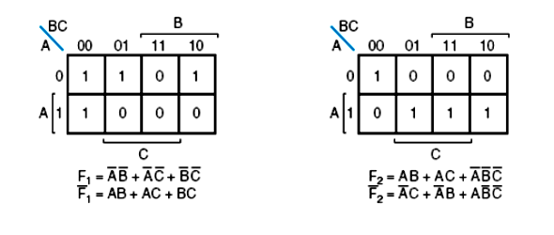
Example 1:
Implement the following two boolean function with a PLA.
F1( A, B, C) = Σ ( 0, 1, 2, 4)
F2 ( A, B, C) = Σ ( 0, 5, 6, 7)
Each product term in the expression requires an AND gate. To minimize the cost, it is necessary to simplify the function to a minimum number of product terms.
F1= (AB + AC + BC)’
F2= (A’C + A’B + AB’C’)’
The combination that gives a minimum number of product terms is: F1’ = AB + AC + BC OR F1 = ( AB + AC + BC )’ F2 = AB + AC + A’B’C’ This gives only 4 distinct product terms: AB, AC, BC, and A’B’C’.

Slide 16
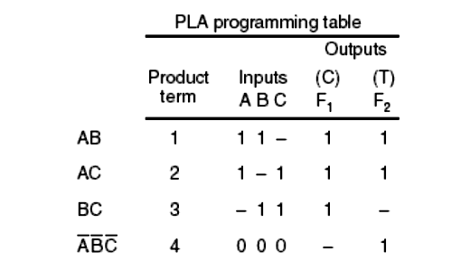
So the PLA table will be as follows:
For each product term, the inputs are marked with 1, 0, or – (dash). If a variable in the product term appears in its normal form (unprimed), the corresponding input variable is marked with a 1.
A 1 in the Inputs column specifies a path from the corresponding input to the input of the AND gate that forms the product term. A 0 in the Inputs column specifies a path from the corresponding complemented input to the input of the AND gate. A dash specifies no connection.

Slide 17
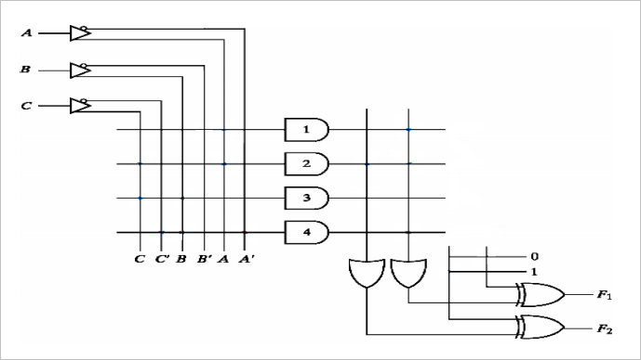
The output is inverted when the XOR input is connected to 1 (since x⊕1 = x’). The output doesn’t change and connect to 0 (since x⊕0 = x).
F1 = ( AB + AC + BC )’
F2 = AB + AC + A’B’C’
AB
AC
BC
A’B’C’
Figure: PLA Implementation

Slide 18
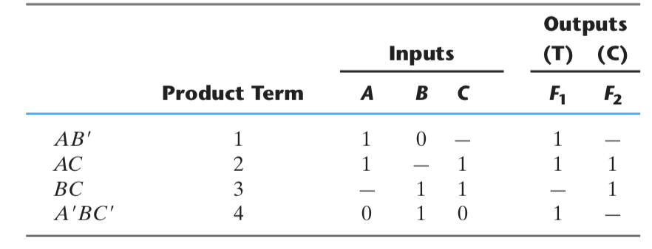
Example 2:
Implement the following function using PLA
F1 = Σ m ( 2, 4, 5, 7)
F2 = Σ m ( 0, 1, 2, 4, 6)
OR
F1 = AB’ + AC + A’BC’
F2 = ( AC + BC)’
Implementation Table

Slide 19
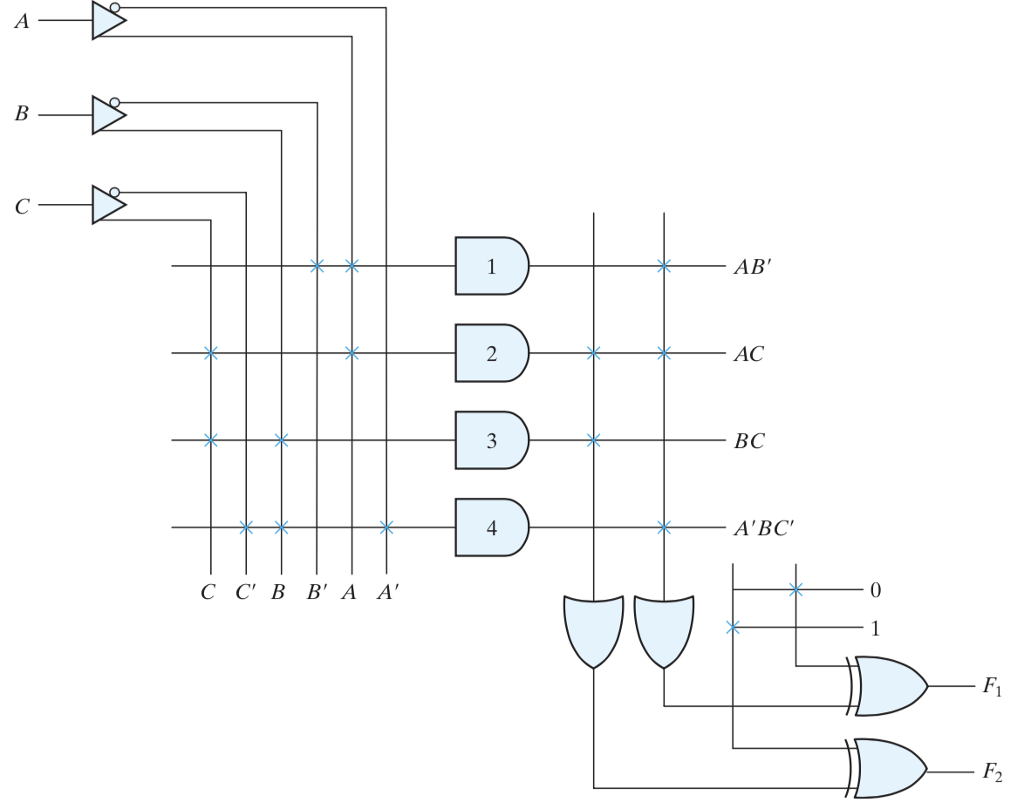
=AB’ + AC + A’BC’
=( AC + BC)’
Figure: PLA Implementation

